Slide 1
Concepts of Database Management
Sixth Edition
Chapter 5
Database Design 1: Normalization

Slide 2
Objectives
Discuss functional dependence and primary keys
Define first normal form, second normal form, and fourth normal form
Describe the problems associated with tables (relations) that are not in first normal form, second normal form, or third normal form, along with the mechanism for converting to all three
Discuss the problems associated with incorrect conversions to third normal form
Concepts of Database Management

Slide 3
Objectives (continued)
Describe the problems associated with tables (relations) that are not in fourth normal form and describe the mechanism for converting to fourth normal form
Understand how normalization is used in the database design process
Concepts of Database Management

Slide 4
Introduction
Normalization process
  Identifying potential problems, called updating anomalies, in the design of a relational database
  Methods for correcting these problems
Normal form: table has desirable properties
  First normal form (1NF)
  Second normal form (2NF)
  Third normal form (3NF)
  Fourth normal form (4NF)
Concepts of Database Management

Slide 5
Introduction (continued)
Normalization
  Table in first normal form better than table not in first normal form
  Table in second normal form better than table in first normal form, and so on
  Goal: new collection of tables that is free of update anomalies
Concepts of Database Management

Slide 6
Functional Dependence
Column B is functionally dependent on column A
  Each value for A is associated with exactly one value of B
  A → B
  A functionally determines B
Concepts of Database Management

Slide 7
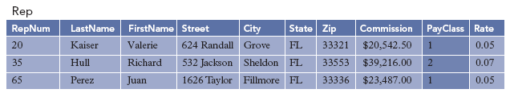
Functional Dependence (continued)
FIGURE 5-2: Rep table with additional column, PayClass
Concepts of Database Management

Slide 8
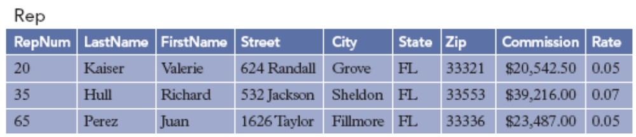
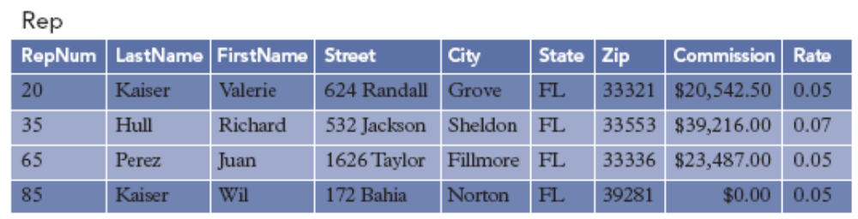
Functional Dependence (continued)
FIGURE 5-3: Rep table
FIGURE 5-4: Rep table with second rep named Kaiser added
Concepts of Database Management

Slide 9
Keys
Column A (or a collection of columns) is the primary key for a relation R
  Property 1: all columns in R are functionally dependent on A
  Property 2: no subcollection of columns in A also have Property 1
Candidate key: column(s) on which all columns in table are functionally dependent
Alternate keys: candidate keys not chosen as primary key
Concepts of Database Management

Slide 10
First Normal Form
Repeating group: multiple entries for a single record
Unnormalized relation: contains a repeating group
Table (relation) in first normal form (1NF) does not contain repeating groups
Concepts of Database Management

Slide 11
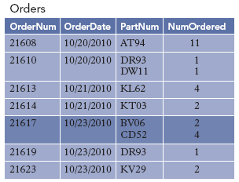
First Normal Form (continued)
Orders (OrderNum, OrderDate, (PartNum, NumOrdered) )
FIGURE 5-5: Sample unnormalized table
Concepts of Database Management

Slide 12
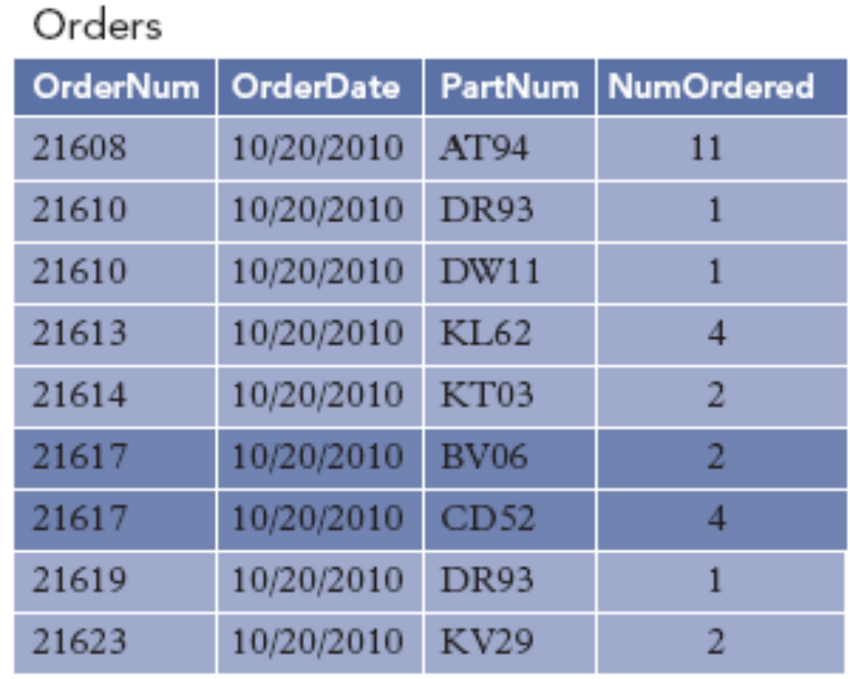
First Normal Form (continued)
Orders (OrderNum, OrderDate, PartNum, NumOrdered)
FIGURE 5-6: Result of normalization (conversion to first normal form)
Concepts of Database Management

Slide 13
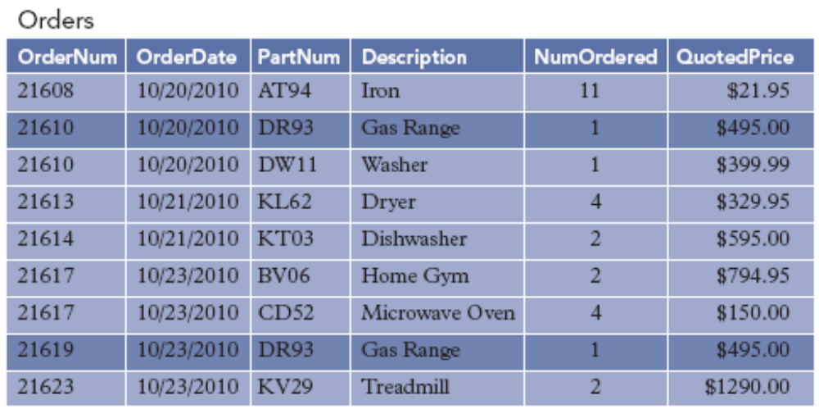
Second Normal Form
FIGURE 5-7: Sample Orders table
Concepts of Database Management

Slide 14
Second Normal Form (continued)
Orders (OrderNum, OrderDate, PartNum, Description, NumOrdered, QuotedPrice)
Functional dependencies:
  OrderNum → OrderDate
  PartNum → Description
  OrderNum, PartNum → NumOrdered, QuotedPrice, OrderDate, Description
Concepts of Database Management

Slide 15
Second Normal Form (continued)
Update anomalies
  Update
  Inconsistent data
  Additions
  Deletions
Nonkey column (nonkey attribute): not part of primary key
Concepts of Database Management

Slide 16
Second Normal Form (continued)
Table (relation) in second normal form (2NF)
  Table is in first normal form
  No nonkey column is dependent on only a portion of primary key
Dependency diagram: arrows indicate all functional dependencies
  Arrows above boxes: normal dependencies
  Arrows below boxes: partial dependencies
Partial dependencies: only on a portion of the primary key
Concepts of Database Management

Slide 17
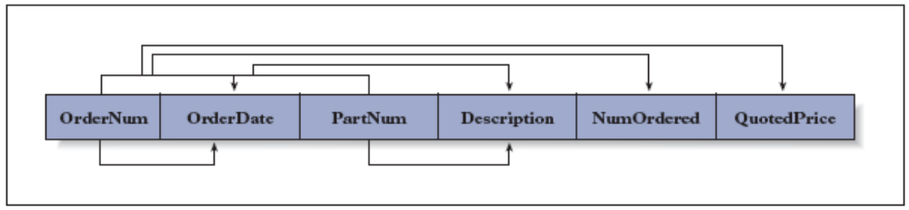
Second Normal Form (continued)
FIGURE 5-8: Dependences in the Orders table
Concepts of Database Management

Slide 18
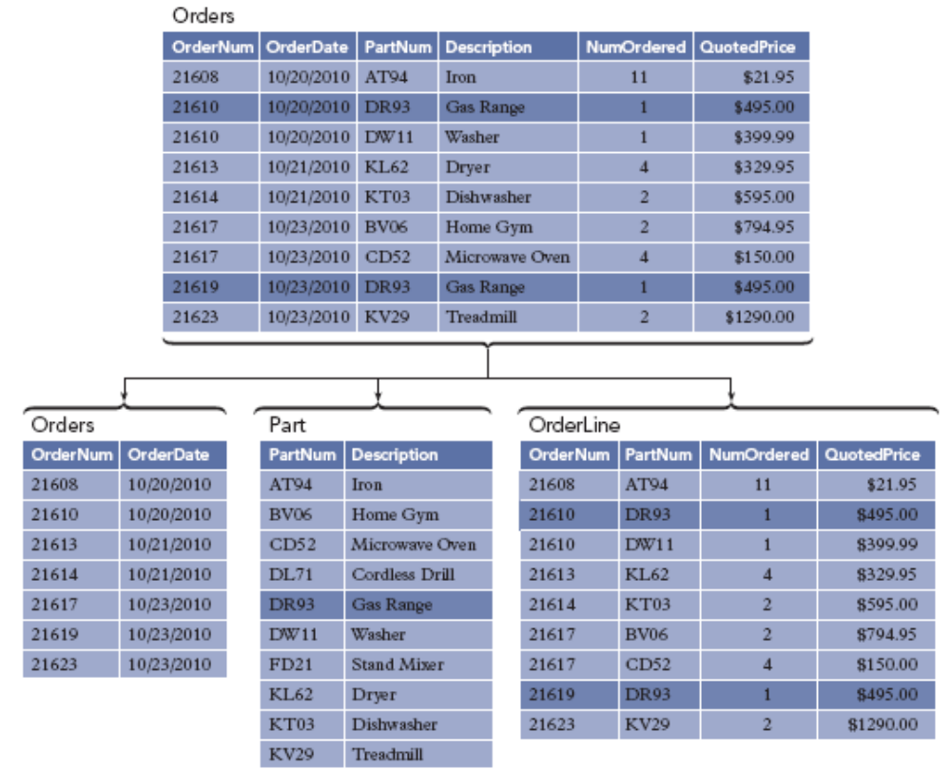
Second Normal Form (continued)
FIGURE 5-9: Conversion to second normal form
Concepts of Database Management

Slide 19
Third Normal Form
Customer (CustomerNum, CustomerName, Balance, CreditLimit, RepNum, LastName, FirstName)
Functional dependencies:
  CustomerNum → CustomerName, Balance, CreditLimit, RepNum, LastName, FirstName
  RepNum → LastName, FirstName
Concepts of Database Management

Slide 20
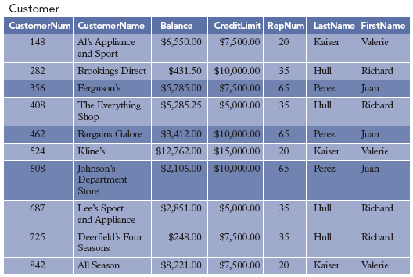
Third Normal Form (continued)
FIGURE 5-10: Sample Customer table
Concepts of Database Management

Slide 21
Third Normal Form (continued)
2NF tables may still contain problems
  Redundancy and wasted space
  Update anomalies
    Update
    Inconsistent data
    Additions
    Deletions
Determinant: column(s) that determines another column
Concepts of Database Management

Slide 22
Third Normal Form (continued)
Table (relation) in third normal form (3NF)
  It is in second normal form
  Its only determinants are candidate keys
Concepts of Database Management

Slide 23
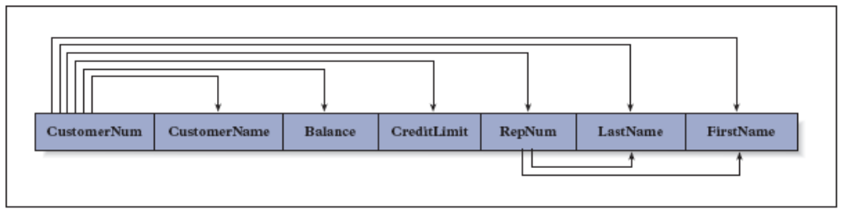
Third Normal Form (continued)
FIGURE 5-11: Dependencies in the Customer table
Concepts of Database Management

Slide 24
Third Normal Form (continued)
Correction procedure
  For each determinant that is not a candidate key, remove from table the columns that depend on this determinant
  Create new table containing all columns from the original table that depend on this determinant
  Make determinant the primary key of new table
Concepts of Database Management

Slide 25
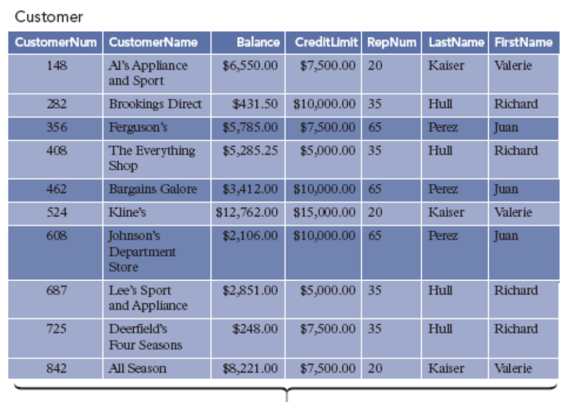
Third Normal Form (continued)
FIGURE 5-12: Conversion to third normal form
Concepts of Database Management

Slide 26
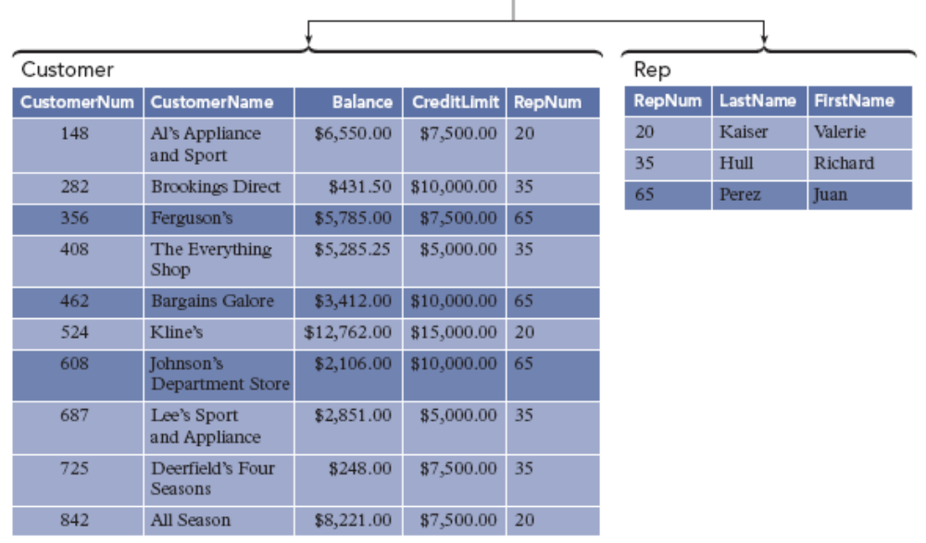
Third Normal Form (continued)
FIGURE 5-12: Conversion to third normal form (continued)
Concepts of Database Management

Slide 27
Incorrect Decompositions
Decomposition must be done using method described for 3NF
Incorrect decompositions can lead to tables with the same problems as original table
Concepts of Database Management

Slide 28
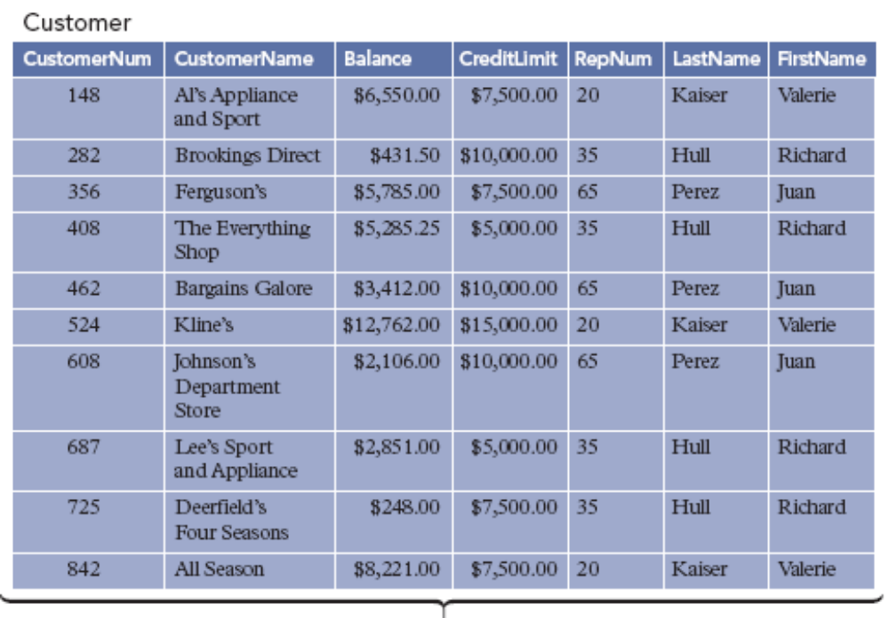
Incorrect Decompositions (continued)
FIGURE 5-13: Incorrect decomposition of the Customer table
Concepts of Database Management

Slide 29
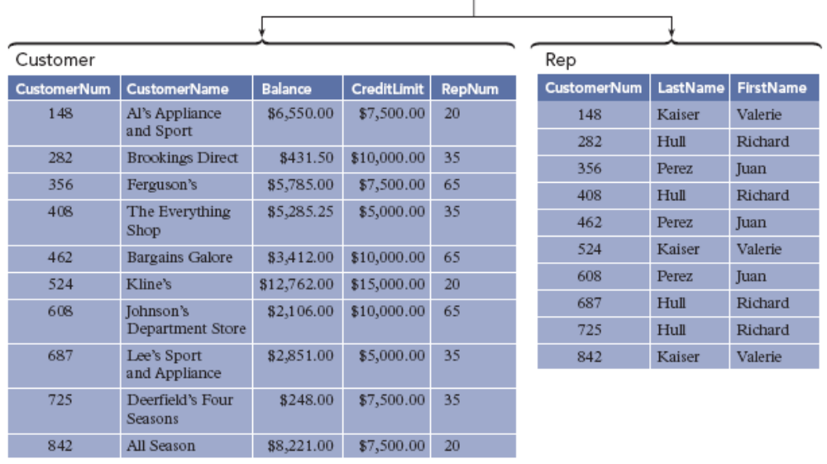
Incorrect Decompositions (continued)
FIGURE 5-13: Incorrect decomposition of the Customer table (continued)
Concepts of Database Management

Slide 30
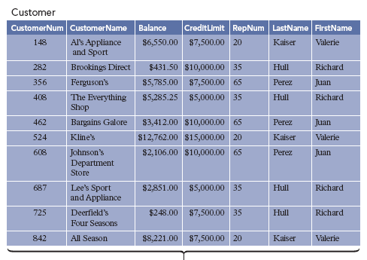
Incorrect Decompositions (continued)
FIGURE 5-14: Second incorrect decomposition of the Customer table
Concepts of Database Management

Slide 31
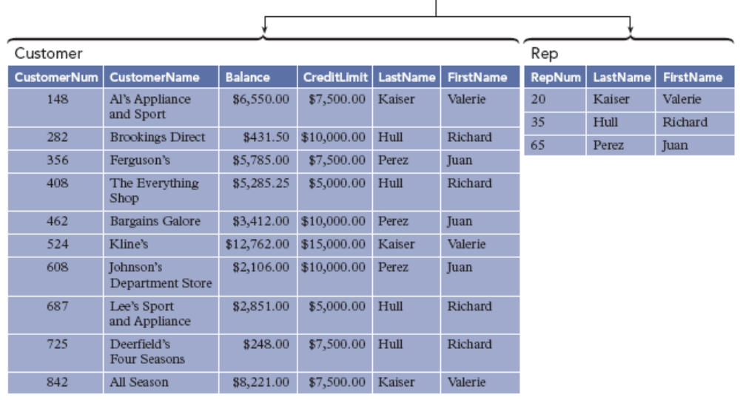
Incorrect Decompositions (continued)
FIGURE 5-14: Second incorrect decomposition of the Customer table (continued)
Concepts of Database Management

Slide 32
Multivalued Dependencies and Fourth Normal Form
3NF tables may still contain problems
  Updates
  Additions
  Deletions
Multivalued dependence of column B on column A
  “B is multidependent on A”
  “A multidetermines B”
  Each value for A is associated with a specific collection of values for B, and this collection is independent of any values for C
  A → → B
Concepts of Database Management

Slide 33
Multivalued Dependencies and Fourth Normal Form (continued)
Table (relation) in fourth normal form (4NF)
  It is in third normal form
  No multivalued dependencies
Converting table to fourth normal form
  Split third normal form table into separate tables, each containing the column that multidetermines the others
Concepts of Database Management

Slide 34
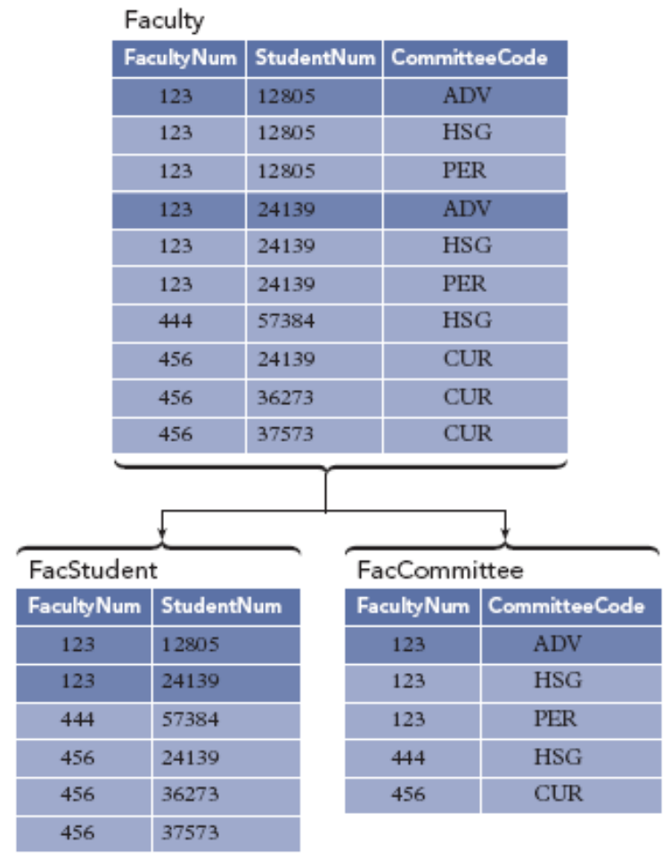
Multivalued Dependencies and Fourth Normal Form (continued)
FIGURE 5-16: Conversion to fourth normal form
Concepts of Database Management

Slide 35
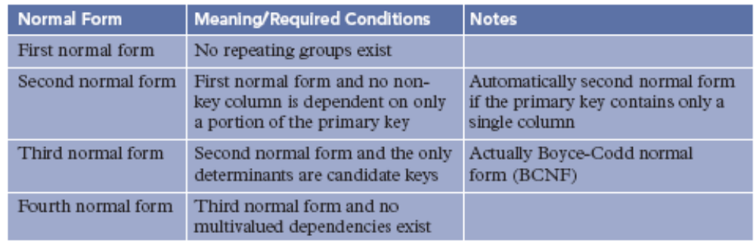
Multivalued Dependencies and Fourth Normal Form (continued)
FIGURE 5-17: Normal forms
Concepts of Database Management

Slide 36
Avoiding the Problem with Multivalued Dependencies
Slightly more sophisticated method for converting unnormalized table to first normal form
  Place each repeating group in separate table
  Each table will contain all columns of a repeating group, and primary key of the original table
  Primary key to each new table will be the concatenation of the primary keys of the original table and the repeating group
Concepts of Database Management

Slide 37
Application to Database Design
Carefully convert tables to third normal form
Review assumptions and dependencies periodically to see if changes to design are needed
Splitting relations to achieve third normal form tables creates need for an interrelation constraint
  Interrelation constraint: condition that involves two or more relations
Concepts of Database Management

Slide 38
Summary
Column (attribute) B is functionally dependent on another column A (or collection of columns) when each value for A in the database is associated with exactly one value of B
Column(s) A is the primary key if all other columns are functionally dependent on A and no subcollection of columns in A also have this property
When there is more than one choice for primary key, one possibility is chosen to be the primary key; others called candidate keys
Concepts of Database Management

Slide 39
Summary (continued)
Table (relation) in first normal form (1NF) does not contain repeating groups
Nonkey column (or nonkey attribute) is not a part of the primary key
Table (relation) is in the second normal form (2NF) when it is in 1NF and no nonkey column is dependent on only a portion of the primary key
Determinant is a column that functionally determines another column
Concepts of Database Management

Slide 40
Summary (continued)
Table (relation) is in third normal form (3NF) when it is in 2NF and its only determinants are candidate keys
Collection of tables (relations) that is not in third normal form has inherent problems called update anomalies
Table (relation) is in fourth normal form (4NF) when it is in 3NF and there are no multivalued dependencies
Concepts of Database Management

